Slide 1


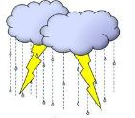




WEATHER FORECAST

Slide 2
SUMMARY
This weather forecasting web application provides real-time weather updates based on user input.
It features an interactive UI with a background video, a search bar, and dynamic weather data display.
Users can enter a city name to fetch weather details using the OpenWeatherMap API.
The script retrieves temperature, humidity, pressure, wind speed, and a weather icon, displaying the data dynamically.
If the city is not found, an error message appears.
The app uses HTML, CSS, and JavaScript for seamless functionality.
The video background enhances visual appeal, while hidden elements are revealed upon successful data retrieval for an engaging user experience.

Slide 3
CODE HIGHLIGHT

Slide 4
1 HTML STRUCTURE
CODE
<div class="box">
<div class="search">
<input type="text" class="name" placeholder="Search city">
</div>
<div class="glass">
<button class="press" onclick="getWeather()">Search</button>
</div>
</div>
EXPLANATION
This section contains an input field where users can type a city name.
The button triggers the getWeather() function to fetch and display weather data

Slide 5
2 FETCHING WEATHER DATA
CODE
const apikey = "your-api-key";
async function getWeather() {
const city = document.querySelector(".name").value.trim();
const apiUrl =…………
try {
const response = await fetch(apiUrl);
if (!response.ok) {
throw new Error("City not found!");
}
const data = await response.json();
document.getElementById("city-name").textContent = data.name;
document.getElementById("temperature").innerHTML = `${data.main.temp}<sup>o</sup>C`;
} catch (error) {
alert(error.message);
}
}
EXPLANATION
Uses OpenWeather API to fetch weather data.
Retrieves temperature, humidity, pressure, and wind speed for the entered city.
Updates the respective HTML elements dynamically.
Handles errors (e.g., when an invalid city name is entered).

Slide 6
3 DISPLAYING WEATHER DATA
CODE
<div class="cname" style="display:none;">
<h5 id="city-name">City</h5>
</div>
<div class="cloud" style="display:none;">
<img id="weather-icon" src="" alt="Weather-Icon">
<h2 id="temperature"></h2>
</div>
EXPLANATION
Initially hidden (display:none;).
Once weather data is fetched, these elements become visible.
Displays the city name, temperature, and a corresponding weather icon.

Slide 7
HOW IT WORKS

Slide 8
User enters a city name in the search bar.
Clicking the search button triggers the getWeather() function.
API fetches weather details for the entered city.
Weather details are displayed dynamically, including temperature, humidity, pressure, wind speed, and an icon.
Error handling: If the city is not found, an alert message appears.

Slide 9
TOOLS
& TECHOLOGIES

Slide 10
HTML: Markup language used to structure the webpage.
CSS: Used for styling the web page, including video and layout elements.
JavaScript: Handles the dynamic functionality of fetching weather data and updating the page.
OpenWeather API: Used to fetch real-time weather data.
Font Awesome: Provides weather-related icons.
Video File: Adds a background video to enhance the page’s aesthetic.

Slide 11
RESULT
OUTPUT

Slide 12
A search input for the city and a button to trigger the weather data retrieval.
A video background playing on the page.
Upon a successful search, the city name, temperature, weather icon, humidity, pressure, and wind speed will be displayed on the page

Slide 13
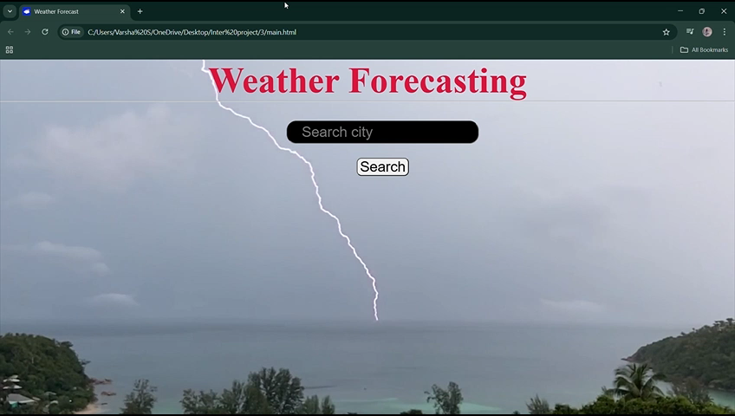
HOME PAGE

Slide 14
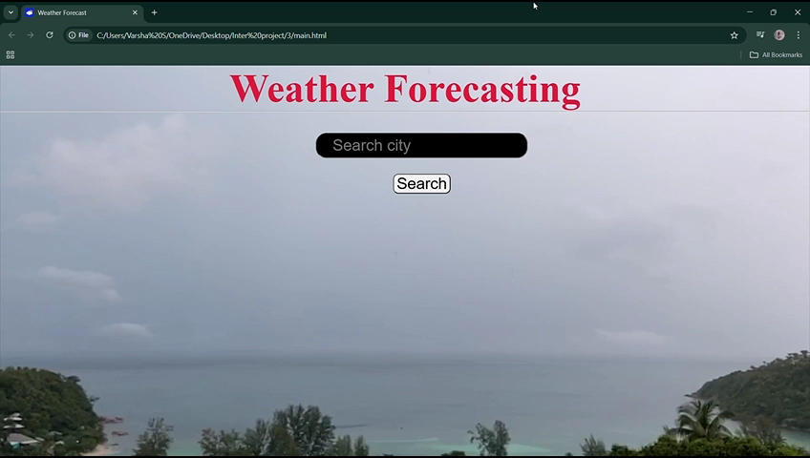
FINAL DEMO

Slide 15
THANK YOU

